Slide 1
POD Update for Drive Orders
POD Procedure Training
Orders must be closed within the given timeline
* SBD ORDERS (DCR, DSC, DHW)
Must be closed within 60mins upon delivery

Slide 2
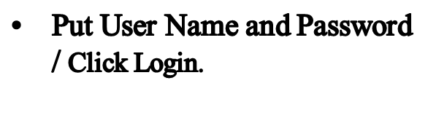
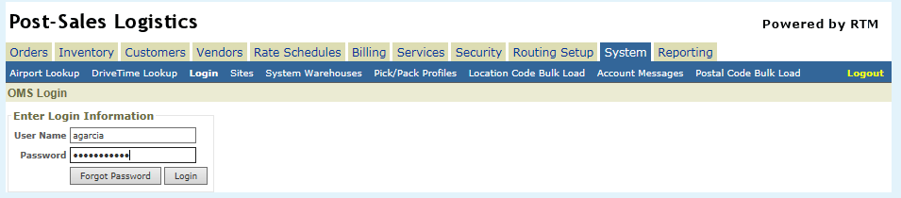
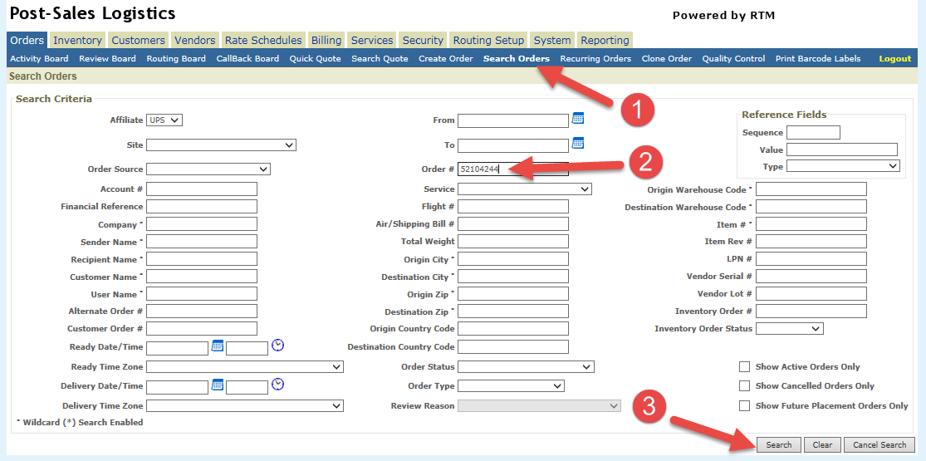
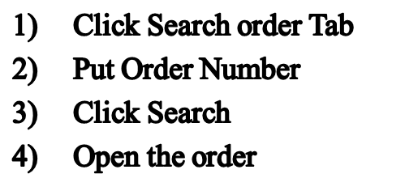
Closing Orders in RTM (Drive Order)
Click for the Link: http://www.upspostsaleslogistics.ups.com/oms/login.screen

Slide 3
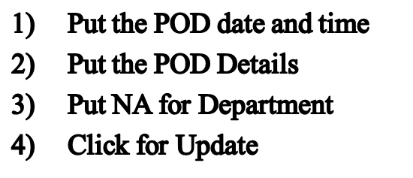
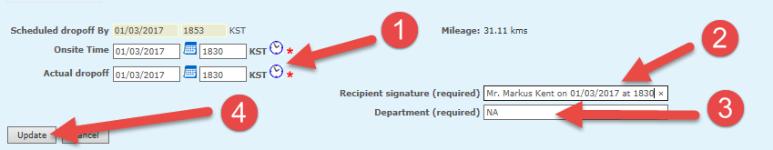
Closing Orders in RTM (Drive Order)

